Slide 1

History of Technical Vocational Training & Apprenticeship in South Africa (1902 - Present)
This presentation explores the evolution of vocational training in South Africa across twelve decades. We'll examine key legislation, socio-political influences, and the journey from exclusion to inclusion.
NM
by Nhlanhla Magwaza

Slide 2
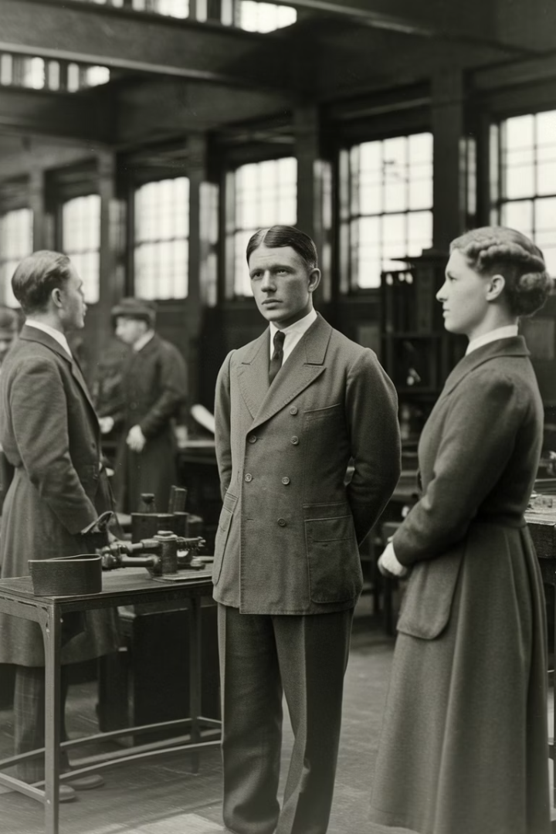



Key Developments & Legislation
Introduction
This presentation examines the evolution of technical vocational training in South Africa.
Historical Context
We'll explore how political, economic, and social factors shaped vocational education.
Current Landscape
The presentation concludes with modern reforms and ongoing challenges.

Slide 3
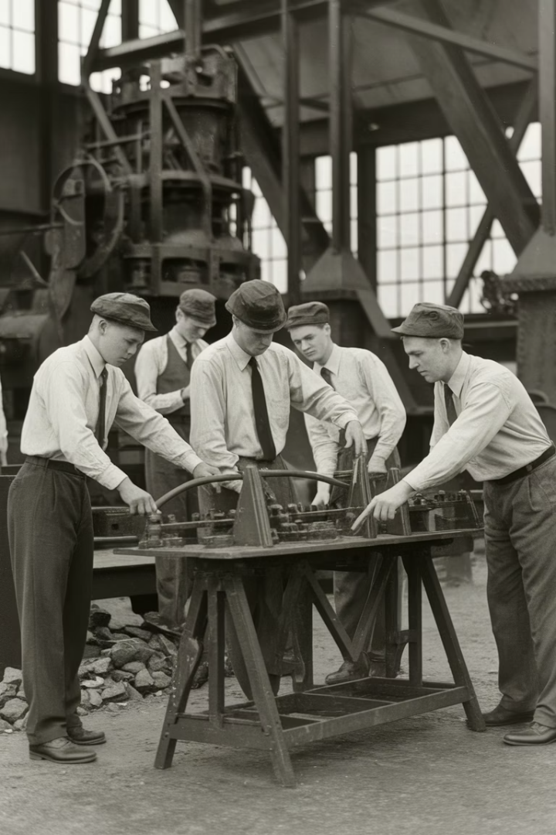




Early Foundations (1902-1920s)
Post-War Reconstruction
After the Anglo-Boer War, technical education emerged as a priority.
Transvaal Technical Institute
Established in 1903 to develop skills for mining and railways.
Racial Restrictions
Training focused exclusively on white artisans.
Provincial Governance
No national legislation existed. Provincial ordinances governed training.

Slide 4



Industrial Consolidation (1920s-1940s)
Apprenticeship Act No. 26
Passed in 1922 to standardize training practices nationwide.
Standard Contracts
Formalized duration, wages, and conditions for apprentices.
World War II Impact
War increased industrial demand for skilled labor.
Despite standardization, the system remained racially exclusive. Only white males could access formal apprenticeship opportunities.

Slide 5








Apartheid Era & Job Reservation (1950s-1980s)
Bantu Education Act
Manpower Training Act
1953 legislation formalized educational segregation.
1963 law replaced Apprenticeship Act with expanded focus.
Job Reservation
Technical Colleges
Black South Africans faced severe restrictions in skilled trades.
Network expanded but remained racially segregated.

Slide 6
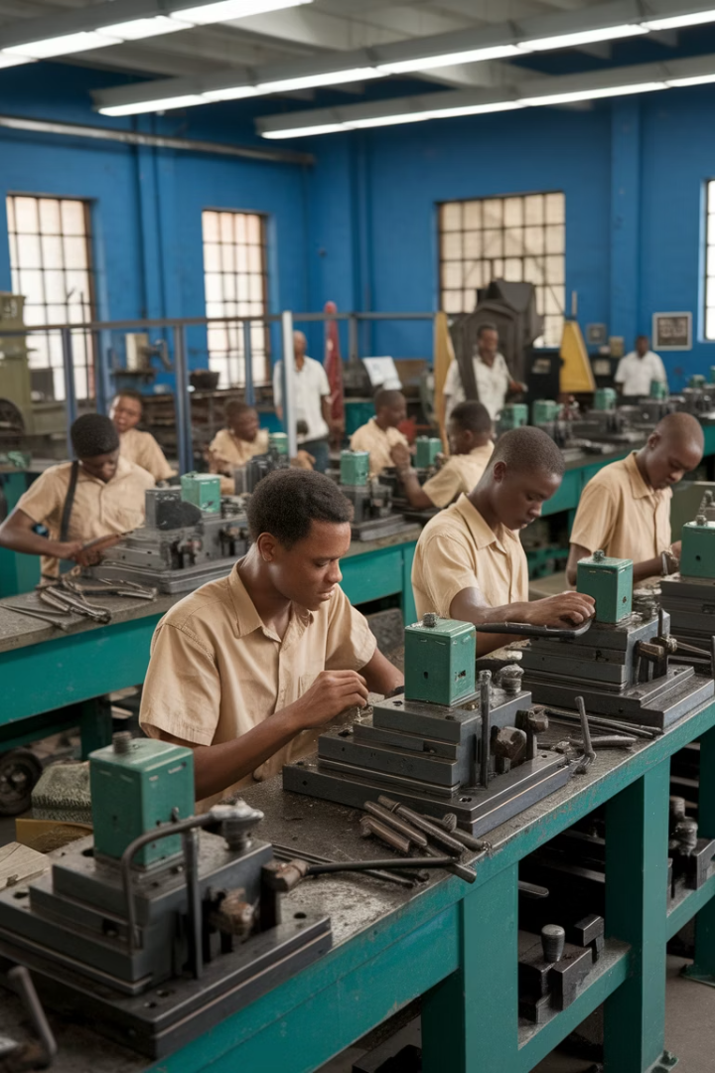
Towards Inclusion (1970s-1980s)
Skills Demand Growth
Manpower Act Amendments
Economic expansion created workforce shortages. Industries pressured government for training reform.
Legal changes allowed limited access for Black South Africans. Restrictions remained significant.
Homeland Technical Schools
Separate facilities established in Bantustans. Quality and resources varied dramatically.

Slide 7






Transition to Democracy (1990s)
Skills Development Act
1998 legislation revolutionized vocational training
Skills Development Levies Act
Established funding mechanism through employer contributions
SAQA and NQF
Created qualification framework and quality assurance
The democratic transition brought fundamental reforms aimed at inclusivity. SETAs replaced industry training boards. Learnerships expanded opportunities beyond traditional apprenticeships.

Slide 8





Modern Reforms (2000s-Present)
NQF Amendment Act (2008)
Created QCTO to oversee occupational qualifications. Established formal quality assurance systems.
NAMB Establishment (2010)
National Artisan Moderation Body standardized trade testing. Improved consistency across provinces.
Decade of the Artisan (2015)
Campaign promoted technical careers. Aimed to produce 30,000 artisans annually.
Ministerial Directive (2023)
Phased out legacy qualifications. Transitioned to occupational certificates.

Slide 9
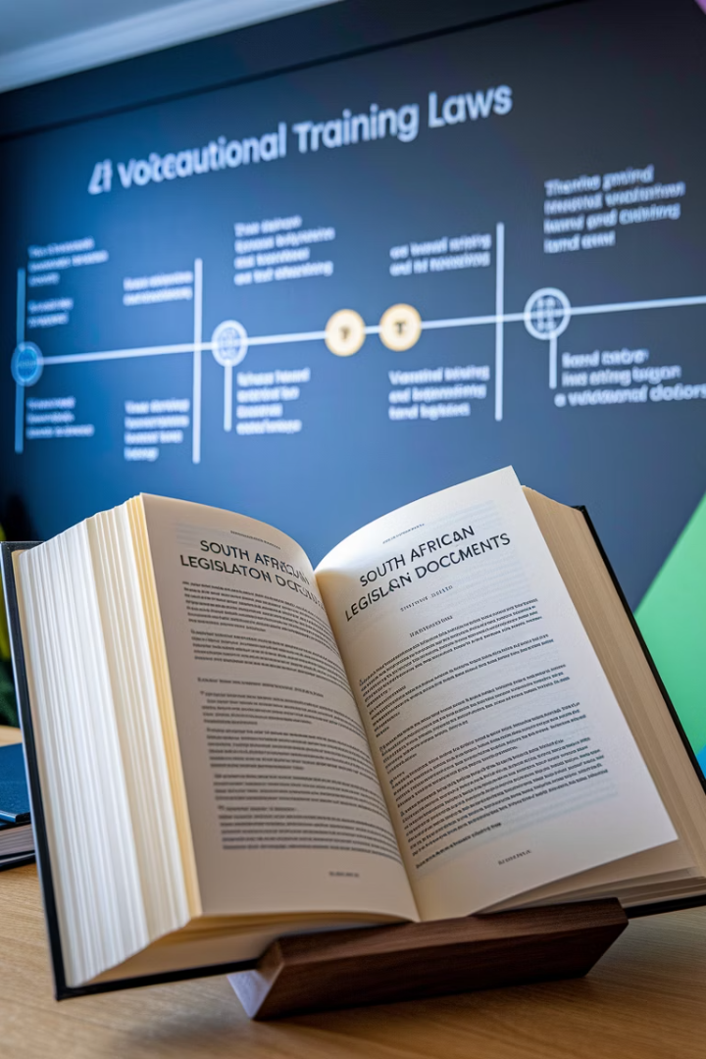
Key Legislation Timeline
Year
Legislation
Impact
1922
Apprenticeship Act
Formalized artisan training (whites only)
1953
Bantu Education Act
Segregated technical education
1963
Manpower Training Act
Expanded training for whites
1998
Skills Development Act
Created SETAs, learnerships
2008
NQF Amendment Act
Established QCTO

Slide 10

Summary & Impact
121
50+
Years of Evolution
TVET Colleges
From exclusionary to inclusive system
Across nine provinces
21
SETAs
Sector Education and Training Authorities
South African TVET has transformed from a racially exclusive system to an inclusive framework. Current focus emphasizes demand-led occupational qualifications. Implementation relies on coordination between QCTO, NAMB, and SETAs.

Slide 11




Thank You & Contact Information
Nhlanhla Magwaza
Email
Organizations
President, APASA and TVT Student at University of KwaZulu-Natal
President@apasa-npc.org.za
APASA, UKZN and merSETA
Questions and discussion are welcome. Please reach out for additional information about South Africa's technical vocational training history and current initiatives.

